Slide 1
Electronics and Payload

Slide 2
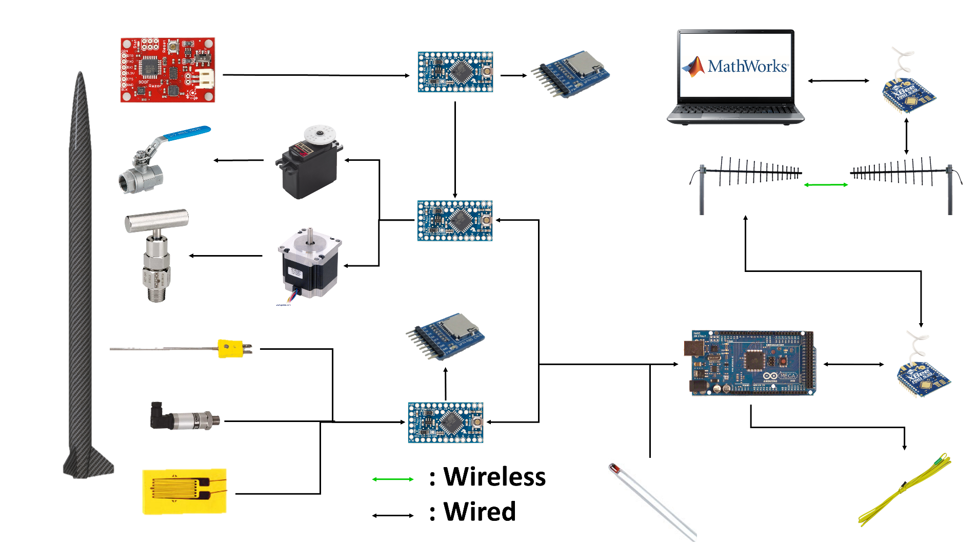
Data & Communication Systems Architecture
Wireless Comm.
Electronics & Payload

Slide 3
Data Transmission
One wireless channel between launch box and launch operations computer
Use launch operations computer to send command to launch box
MathWorks includes support package for Arduino communication
Arduino receives command then sends back that it received command
If Arduino does not acknowledge, we will know to send command again
Arduino sends status update when command is completed
In case of sensors, data collection begins
In case of one-time command, a short message is sent
Wireless Comm.
Electronics & Payload

Slide 4
Sensors
Necessary for testing and flight data collection
Vehicle will contain an IMU, two pressure sensors, and three thermocouples
Data will be read in and processed by Arduino Pro Minis
System very flexible
Allows for additional sensor or microcontrollers
Data stored in 32 GB microSD cards
Flight Sensors
Electronics & Payload

Slide 5
Propulsion Safety Shutoff
Propulsion would like an automatic engine shutoff
IMU Data continually processed to determine need based on vehicle orientation
In event of shutdown, oxidizer’s ball valve is closed and the venting needle valve is opened
Engine Safety
Electronics & Payload
Notes:
Data in sensors is inherently “jumpy” so multi-data-point average necessary for useful data
Thorough testing of IMU necessary to test for drift
Speed of ball valve closure greatly determines effectiveness of such measures

Slide 6
Power Requirements
Sensor | Voltage Draw | Current Draw (ea) | Power Draw (ea) | Quantity
Thermocouple | 3.3 V | Negligible | N/A | 3
IMU | 3.3 V | 1.2 mA | 3.96 mW | 1
Strain Gauge | 5 V | 100 mA | 500 mW | 2
Pressure Transducer | 12 V | 10 mA | 120 mW | 2
Arduino Pro Mini | 5 V | 25 mA | 125 mW | 3
Flight Total: | - | 296.2.2 mA | 1.619 W | 11
Will be utilizing last year’s battery
Arduinos require much less power than BeagleBones so have plenty of energy to spare with last years battery
This means any additional sensors added do not cause a concern with regard to power
Power
Electronics & Payload
Notes:
Arduinos are able to output 500 mA each

